Slide 1
Welcome at this
PLCopen presentation on Safety
Check also the notes coupled to each slide
Notes:
1
Welcome at this presentation
Feel free to adopt this one to your own needs – there is no copyright on it, but make sure you make a reference to PLCopen in your presentation
Welcome here in the notes of this presentation. These notes provide you additional information on the subject
For certain pictures we use several slides to construct it – making it easier for you to adapt them
For feedback please contact Eelco van der Wal at evdwal@PLCopen.org – thanks in advance
Learn and enjoy

Slide 2



PLCopen Safety
The natural addition to
Logic and Motion
Notes:
Welcome at this presentation on PLCopen Safety, which is the result of the PLCopen Technical Committee 5 – TC5.
PLCopen Safety is a natural addition to the existing specifications for Logic (IEC 61131-3) and the suite of PLCopen Motion Control Specifications.
See separate presentations on those two items.

Slide 3
Reasons to merge – a changing environment
Too many dialects, too many standards, including IEC 61508 and IEC 62061;
Additional governmental requirements increasing the liability issues;
No independent training material
Trend to software solutions
Too much done by machine builder
Growing market expected
Notes:
There are many reasons to merge the logic and motion with safety. First of all there are so many safety standards that a machine builder cannot even know them all, let alone use them correctly. Yet in the end they are still responsible for their products and related safety aspects. This risk situation is not very healthy, especially since legislation imposes greater constraints on the equipment suppliers. And their liability increases. So that is where PLCopen tries to help – support the usage of safety via harmonization.

Slide 4
Reasons to merge – a changing environment
The tendency to move from one motor (master axis) to multiple axes, driven by mechatronic solutions;
The availability and acceptance of digital networks with safety functionality built-in;
The inherent move from hardwired safety functionalities to software solutions;
The increasing importance of safety related issues regarding personnel and machines (Governmental requirements).
Notes:
Nowadays safety becomes a software issue. With digital networks that includes communication to safety related sensors and actuators, like emergency stop, there is no way around it. And due to governmental rules and laws, the responsibility lies much more at the machine builder, so one has to reduce the risk.
This means that the machine builders’ responsibility for their products and related safety aspects is clearer than ever before, and in court it should be proven that the utmost had been done to make the machine safe.

Slide 5



TC5 - Safety : Goal
Allow the user to achieve the functional safety
at the machine and plant level
Notes:
The goal for this committee is to allow the user to achieve the functional safety at the machine and plant level.
Although the main focus is on machine safety.

Slide 6
Why integration of safety functionality in the programming environment?
Basis for easier commissioning
Basis for product / architecture independent training
Support for safe programming techniques
Guidelines for the use of the IEC standards
In combination with Function Blocks
Identification via SAFEBOOL datatype
Notes:
The integration of safety functionality in the development environment makes a lot of sense. For this, PLCopen provides:
Easier commissioning of the machine esp. the safety aspects
Provides the basis for independent training, making a better link between education and praxis possible
Strongly supports safe programming techniques to reduce the possible errors
Important is the combination of a new datatype, SAFEBOOL, coupled to dedicated function blocks for safety functionalities. With this the safety related part of the program is easily identifiable, already by the editors, to support safe programming techniques in general.

Slide 7
Overall safety related requirements
The common basic requirements of a safety application for machine builders within all applicable safety standards are:
Distinction between safety and non-safety functionalities
Use of applicable programming languages and language subsets
Use of validated software blocks
Use of applicable programming guidelines
Use of recognized error-reducing measures for the lifecycle of the safety-related software
Notes:
The common basic requirements of a safety application for machine builders within all applicable safety standards are:
• Distinction between safety and non-safety functionalities
• Use of applicable programming languages and language subsets
• Use of validated software blocks
• Use of applicable programming guidelines
• Use of recognized error-reducing measures for the lifecycle of the safety-related software
These are the aspects that PLCopen has included in their definition work.

Slide 8
PLCopen Safety: What is included? (1/2)
Representation of the software architecture
Definition of the programming languages
Presentation of safety-related data types
Definition of language subsets
Definition of user levels for easy programming and error prevention
Notes:
In order to reach its goal, PLCopen has specified different aspects that go beyond the definition of a set of Function Blocks – see slide (1 of 2)

Slide 9
PLCopen Safety: What is included? (2/2)
Error handling and diagnostic concept
Definition of a generic safety-related function block
The definition of a set of safety-related function blocks
The definition of a PLCopen compliance procedure combined with the use of the PLCopen Safety logo
Notes:
Slide 2 of 2. See text in slide

Slide 10
PLCopen Safety – a suite of Specifications
Part 1 - Concepts and Function Blocks
Part 2 - User Examples
Part 3 - Extensions to Part 1
Part 4 - Extensions for Presses
Separate user document: Logic, Motion, Safety
Notes:
PLCopen Safety is a suite of specifications which currently (2014) consists of the following – see slide

Slide 11
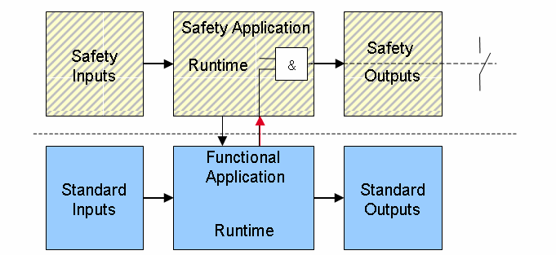
Architectural Model
Notes:
There will be a connection between the safety and the functional application to exchange relevant data. The coupling from the safety environment to the functional application is relative straightforward since one goes outside of the safety environment. The other way around is of course more critical, and needs special conditions. On the left side of the model as shown above, two sets of inputs are identified, and on the right side two levels of outputs. In the middle, the
two environments are shown separately, both coupled to their related inputs and outputs.
The permitted data exchange between the safety and the functional applications is shown in the middle.
• The functional application has read access to the safety inputs and global variables (as indicated by the left arrow).
• The non-safe signals can only be used in the safety application to control program flow and cannot be connected directly
to the safe outputs (as indicated by the right arrow and the AND operator).
The same applies to the two sets of outputs.
An example of this coupling is the restart after a release of the emergency stop sensor.

Slide 12
Definition of User Levels
Notes:
The specification identifies 3 levels, to reduce the effort for the user significantly by simplifying the releasing process.
1. Basic Level:
A fundamental approach is that the safety program only consists of certified function blocks that can be easily "wired" with one another in graphical form. If, in addition to this, the type of connection is limited, a view adapted to modern technology can be produced, which is similar to the discrete wiring of safety components. The programs have a clear structure and can be easily read. Furthermore, the release time of the program is significantly shortened, as it consists of blocks certified in advance.
2. Extended Level:
In the case of projects, for which the current status of certified function blocks is not sufficient, the user can create the required blocks (or even the program) in the Extended Level. For this, an extended command range is provided. However, the validation of the functionality for these blocks and programs can be considerably more complex and therefore more time-consuming since the programs underlie the whole verification process. If the blocks have been certified / validated, they can be used in the Basic Level together with the advantages described above.
3. System Level:
The System Level is provided for suppliers of safety controls. The System Level also enables, e.g., implementations in supplier-specific languages. However, the System Level is not part of the specification.

Slide 13
Positioning of the work
Software Development
Safety Runtime
Safety Requirements
LVL
PLCopen Safety
IEC 61131-3 LD, FBD
IEC 62061 (*)
Safety Application
IEC 61508 (-3)
FVL
(C, C++, Ass., others)
Embedded Software,
Firmware, Oper. Systems
IEC 61508 (-3)
(Dedicated)
Hardware
(*) IEC 62061, ISO 13849-1, or IEC 61511
Supplier of Safety Related Controls
Notes:
The focus of the PLCopen Safety specification is on the software development of the safety application, esp. in line with the IEC 62061 for machines.
The safety application will run on a dedicated safety related controller, which is however outside of the scope of PLCopen and should be developed with different tools. Guidance for such a development is specified in specifications like IEC 61508, and different tools can be used.

Slide 14
Reduction in the development environment
Reduction in data types
Reduction in Functionalities
Reduction in Programming Languages
  Graphical languages LD & FBD
Notes:
In order to fulfill the common basic requirements, several reductions in the development environment are defined.
1. The datatypes are limited to SAFEBOOL, BOOL, INT, DINT, REAL, WORD AND TIME.
2. The functionalities in general are reduced to AND, OR TON, TOF, TP, CTU, CTD, CTUD, and in extended level also with XOR, NOT, ADD, MUL, SUB, DIV, GT, GE, EQ, LE, LT, NE, and selection functions, type conversion functions, time functions, and bistable and edge detection functions.
3. The applicable programming languages are limited to the graphical ones, e.g. Ladder Diagram and Function Block Diagram.

Slide 15
Defined Safety FBs in Part 1 (1/2)
Mode Selector
Emergency Stop
Safe Stop category 1 & category 2
Safely Limited Speed
Safety Guard Monitoring
Safety Guard Interlocking with Locking
Electro-Sensitive Protective Equipment
Two-Hand Control Type II and Type III
Notes:
In Part 1 there are also in total 19 Function Blocks defined.
Most of them represent the safety functionality in a direct way, like mode selector and emergency stop.

Slide 16
Defined Safety FBs in Part 1 (2/2)
Testable Safety Sensor
Sequential Muting, Parallel Muting, and Parallel Muting with 2 Sensors
External Device Monitoring
Enable Switch
Safety Request
Out Control
Equivalent and Antivalent
Notes:
Other ones are linked to the basic functionalities or are defining more generic functionalities or are to be used in conjunction with others.
For instance: the Emergency Stop functionality is more an inhibition for a restart of a machine: the real stop functionality is done by a second function block like SafeStop.

Slide 17
Definitions per Safety Function Block
Applicable Safety Standards
Interface Description
Functional Description, incl. State Diagram and typical timing diagrams
Error Detection
Error Behavior
Function Block-Specific Error and Status Codes (on top of the generic diagnostics and error codes)
Notes:
Per function block a common set of definitions are specified – see slide

Slide 18
Example : FB Emergency Stop
Applicable Standards (shortform)
  EN 418: 1992 3. Definitions
        4.1.12 ... Resetting the control device shall not by itself cause a restart command. .
  EN 954-1: 1996 5.4 Manual reset
  ISO 12100-2: 2003 4.11.4: Restart following power failure/spontaneous restart
  EN 16204-1, 1997 9.2.2. Stop Functions
Notes:
As an example of these definitions, let us look at the FB Emergency Stop.
Here is short form we go through the different areas, starting with the applicable safety standards, referencing the applicable functionality.
As listed, it covers sections in several safety standard.

Slide 19
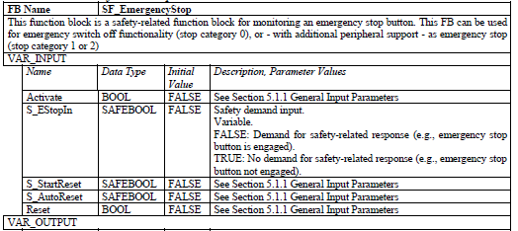
FB Estop – Interface Description (partly)
Notes:
Next the interface description is defined, showing part of the textual description, incl. initial values.
The names starting with S_ have the SAFEBOOL datatype.
The output section is not shown here in detail.

Slide 20
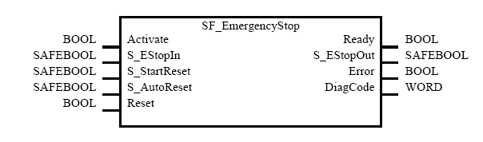
FB Estop – Interface Description (partly)
Notes:
This is the graphical representation, as applicable for the graphical programming languages.

Slide 21
Typical Timing Diagram
Notes:
Here a typical timing diagram for the emergency stop, with on the bottom the diagnostics codes, which reference again to the active state in the state diagram.

Slide 22
State
Diagram
Notes:
And here the state diagram for the emergency stop. Not the different numbers for the states, as referenced by the diagnostic codes.

Slide 23
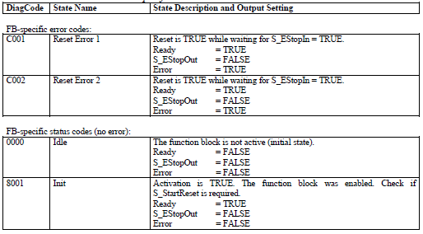
FB Specific Error and Status Codes (partly)
Notes:
The Function Block specific error codes reflect the value of the different outputs in that error state, as partly shown here above.

Slide 24
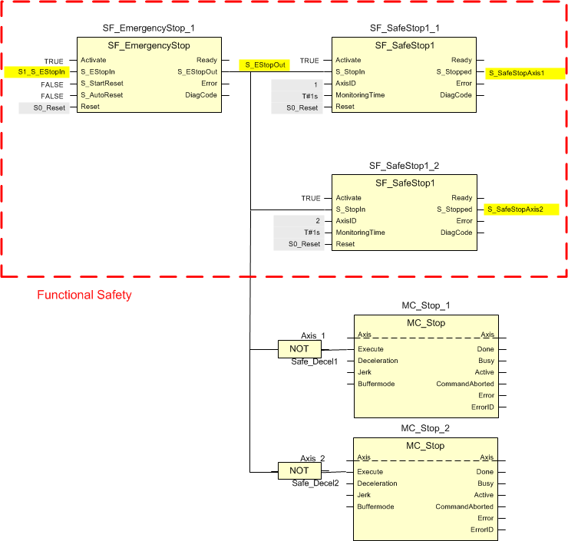
Short example of usage (1 of 2)
Notes:
In this example the emergency stop function is connected 2 axes via 2 SF_SafeStop blocks as well as 2 MC_Stop FBs (see next slide).
The MC_Stop FBs are started to generate a normal stop function of the drives and axes.
The SF_SafeStop functionalities are checking this process and in case the axes did not stop within the specified time frame (1 sec.) the Safe Stop functionality will stop the axes in a safe way.

Slide 25
Short example of usage (2 of 2)

Slide 26
Defined Safety FBs in Part 3 (1/2)
Safety Guard Interlocking with Locking (Version 2)
Safety Guard Interlocking with Locking for switches with serial contacts
Pressure Sensitive Equipment (PSE)
Diagnostic FB
Override
SF_EnableSwitch2 (without detection of panic position)
Notes:
Part 3 has added the following functionalities: see slide
What covers a large section is the harmonization of the diagnostics information, making it easier to present useful information to the operator on what to do. For instance

Slide 27
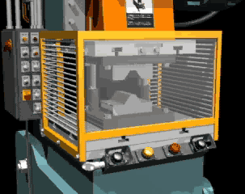
Part 4 – Application for Presses
Notes:
Part 4 is focused to the application area of presses.
A press or a machine press is a tool used to work metal (typically steel) by changing its shape and internal structure.
This covers small sizes to real large machines, like used for body parts in the automotive industry.
The one shown here is a power press with a fixed barrier guard.

Slide 28
Basic Press Cycle
Notes:
A press normally has a moving section which has a cyclic movement.
One can look to a cycle of a press as a 360 degrees circular movement during which certain actions will be applicable during a certain angle of the cycle. In the figure below the cycle is shown at the full 360 degrees, and several actions are shown on 3 different paths. For instance, on path 1 one sees in clockwise motion an activity over the first 85 degrees, as well as at 135 and 225 degrees. The converting of the material could be done in the angle between the 2 last points.
Although there are different types of presses, one can identify this cycle in all of them. The way this cycle is initiated consists basically of 3 different modes:
1. Single cycle: the cycle is only done once and stopped at the end. An initiation has to be done before a next cycle is started
2. 1-Cycle, 2-Cycles which are coupled for instance via a light curtain to the insertion and withdrawal of the product
3. Continuous mode, where the work is on-going.

Slide 29
Safety on Presses
Notes:
Presses can be very dangerous for the operating personnel so special safety functions have to be installed.
To show the combination of the different functionalities, an example for a power press is shown here. The press in the center is seen from the top.
The operator sides are on the top and bottom of the picture. They are protected by both two hand controls (S11-S18) and/or a light curtain (S19 and S20), one on the front side and back side. The two hand control devices are selectable.
Access from the left and the right side of the press are protected by interlocked guards (S21, S22)
On every corner of the press there is an emergency stop button installed.
The operator panel is located on a central position. It contains a mode-selector, and additional emergency stop functionality, the pre-selection for the 4 two-hand-control devices, and a switch for backward move. It also contains a reset button and two indicators (lamps) for status information.

Slide 30
Function Blocks for Presses (1/2)
PLCopen SF_FB | Press Type | Safety function
SF_EmergencyStop | Generic | Emergency stop with start up inhibit
SF_FootSwitch | Generic (P4) | Footswitch with enabling
SF_ESPE | Generic | Light curtain
SF_GuardLocking | Generic | Guard locking with interlocking
SF_GuardMonitoring | Generic | Guard Monitoring
SF_Mode_Selector | Generic | Mode Select (1 of n) 1 of 8 applicable
SF_TwoHandControlTypeIII | Generic | Two hand control Type III
SF_TwoHandControlTypeIIIC | Generic (P4) | Pluggable two hand control
SF_Cycle Control | Mechanical (P4) | Cycle control with single or double break.
Notes:
To support these required safety functionalities, the following FBs are identified to be used. Note that some of the FBs are already specified in Part 1. Part 4 adds specific ones that are listed here with the addition (P4).
Rest see slide

Slide 31
Function Blocks for Presses (2/2)
PLCopen SF_FB | Press Type | Safety function
SF_SingleValveMonitoring | Hydraulic (P4) | Monitoring of valves with direct feedback
SF_SingleValveCycleMonitoring | Hydraulic (P4) | Monitoring of Cartridge Valves
SF_DoubleValveMonitoring | Hydraulic (P4) | Monitoring of double valves (Press Safety Valves)
SF_ValveGroupControl | Generic (P4) | Summarizes all the connected valves to a group
SF_TwoHandMultiOperator | Generic (P4) | Enable for multi operator with two-hand control
SF_CamshaftMonitor | Mechanic & Servo (P4) | Camshaft monitoring (Wellenbruchsicherung)
SF_CamMonitoring | Mechanic (P4) | Monitoring of a crankshaft (Nockenschaltwerk)
SF_PressControl | Mechanic (P4) | Controls the safety related valves depending on mode and protection system
Notes:
See slide.
With these functionalities one can create application programs for presses.

Slide 32
PLCopen
Combining Logic, Motion and Safety
Providing Structuring, Decomposition,
Reuse and less training
Notes:
PLCopen as organization provides the basis for the integration of Logic, Motion and Safety, and with that it provides the basis for you to get more efficiency in automation via structuring, decomposition, reuse and less training. This is a very valuable contribution of the organization PLCopen. Now some words to that.

Slide 33

Some words to the
Not-for-profit organization
Notes:
PLCopen is a not-for-profit organization which originated more then 20 years ago in The Netherlands.
As already shown, PLCopen provides efficiency in automation. How do we operate?

Slide 34
PLCopen as a World-wide association
Main Office in Europe
Office in Korea
Office in North America
Office in China
Office in Japan
Notes:
PLCopen is a world wide non-profit organization, which is headquartered in The Netherlands, and has supporting offices in North America, Japan, and China. Currently we are setting office in Korea. These last organizations have or will have a local website in their local language, making it easier to access the information.

Slide 35
One member – One vote
small companies can have the
same influence as large companies
Notes:
The independency of PLCopen as organization is very important.
For that reason PLCopen has a ‘1 member – 1 vote’ principle, giving smaller companies the same influence as larger corporations.
PLCopen has several membership categories, from large corporations till universities.
For a full list of the members check the website PLCopen.org

Slide 36

Notes:
PLCopen is primarily depending on its members.
They pay an annual fee which provides the basis to operate and to provide services, like this presentation and create the related specification.
And with a multitude of members the independency of the organization is guaranteed.
So think about supporting this organization and be seen as such in the market while influencing your future.

Slide 37





PLCopen – providing a suite of specifications
Notes:
PLCopen brings a suite of specifications to the market covering different areas while combining in to a total concept.

Slide 38
More Information... and to download the specifications (f.o.c)
www.PLCopen.org
Free-of-Charge electronic Newsletter ‘PLCopening’ (in English)
email: evdwal@PLCopen.org
Notes:
More information?? See above
And check the other presentations on the different subjects.

